Slide 1
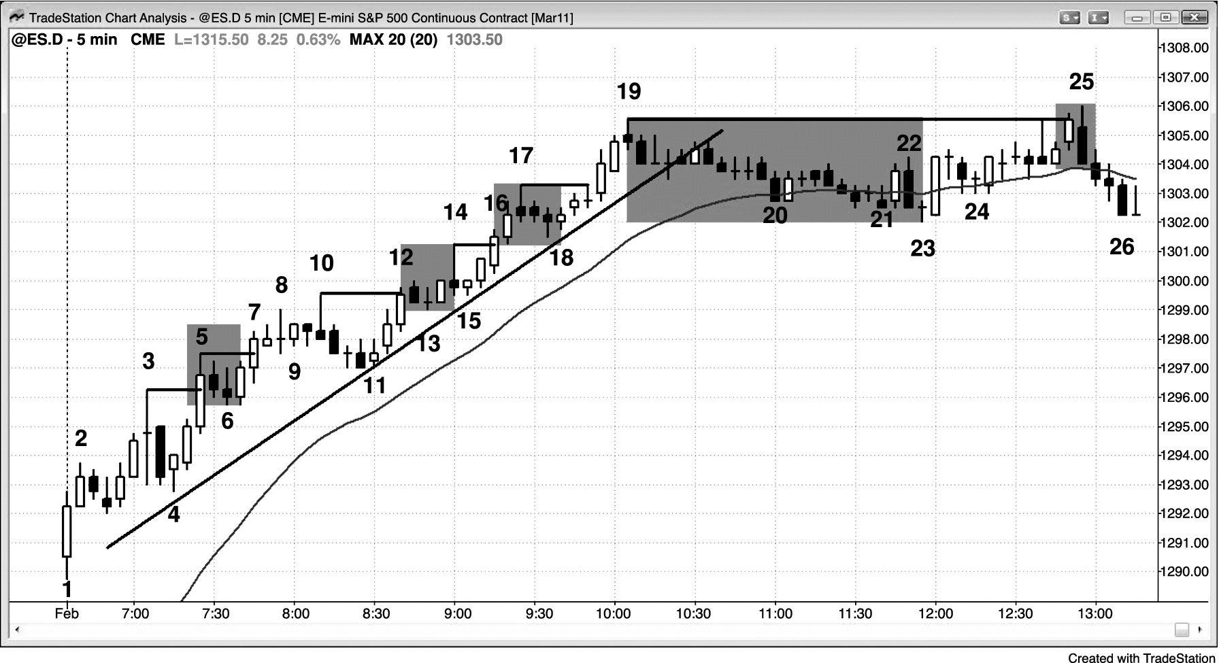
FIGURE PI.1 New Highs Find New Buyers, Profit Takers, and Shorts

Slide 2
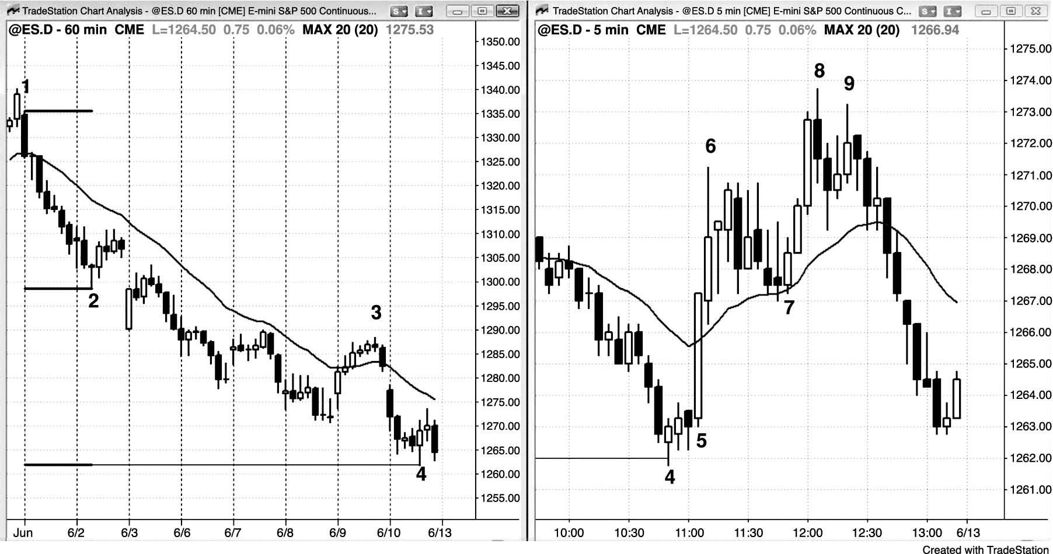
FIGURE PI.2 Low-Volume Bull Breakout in a Bear Trend

